Slide 1
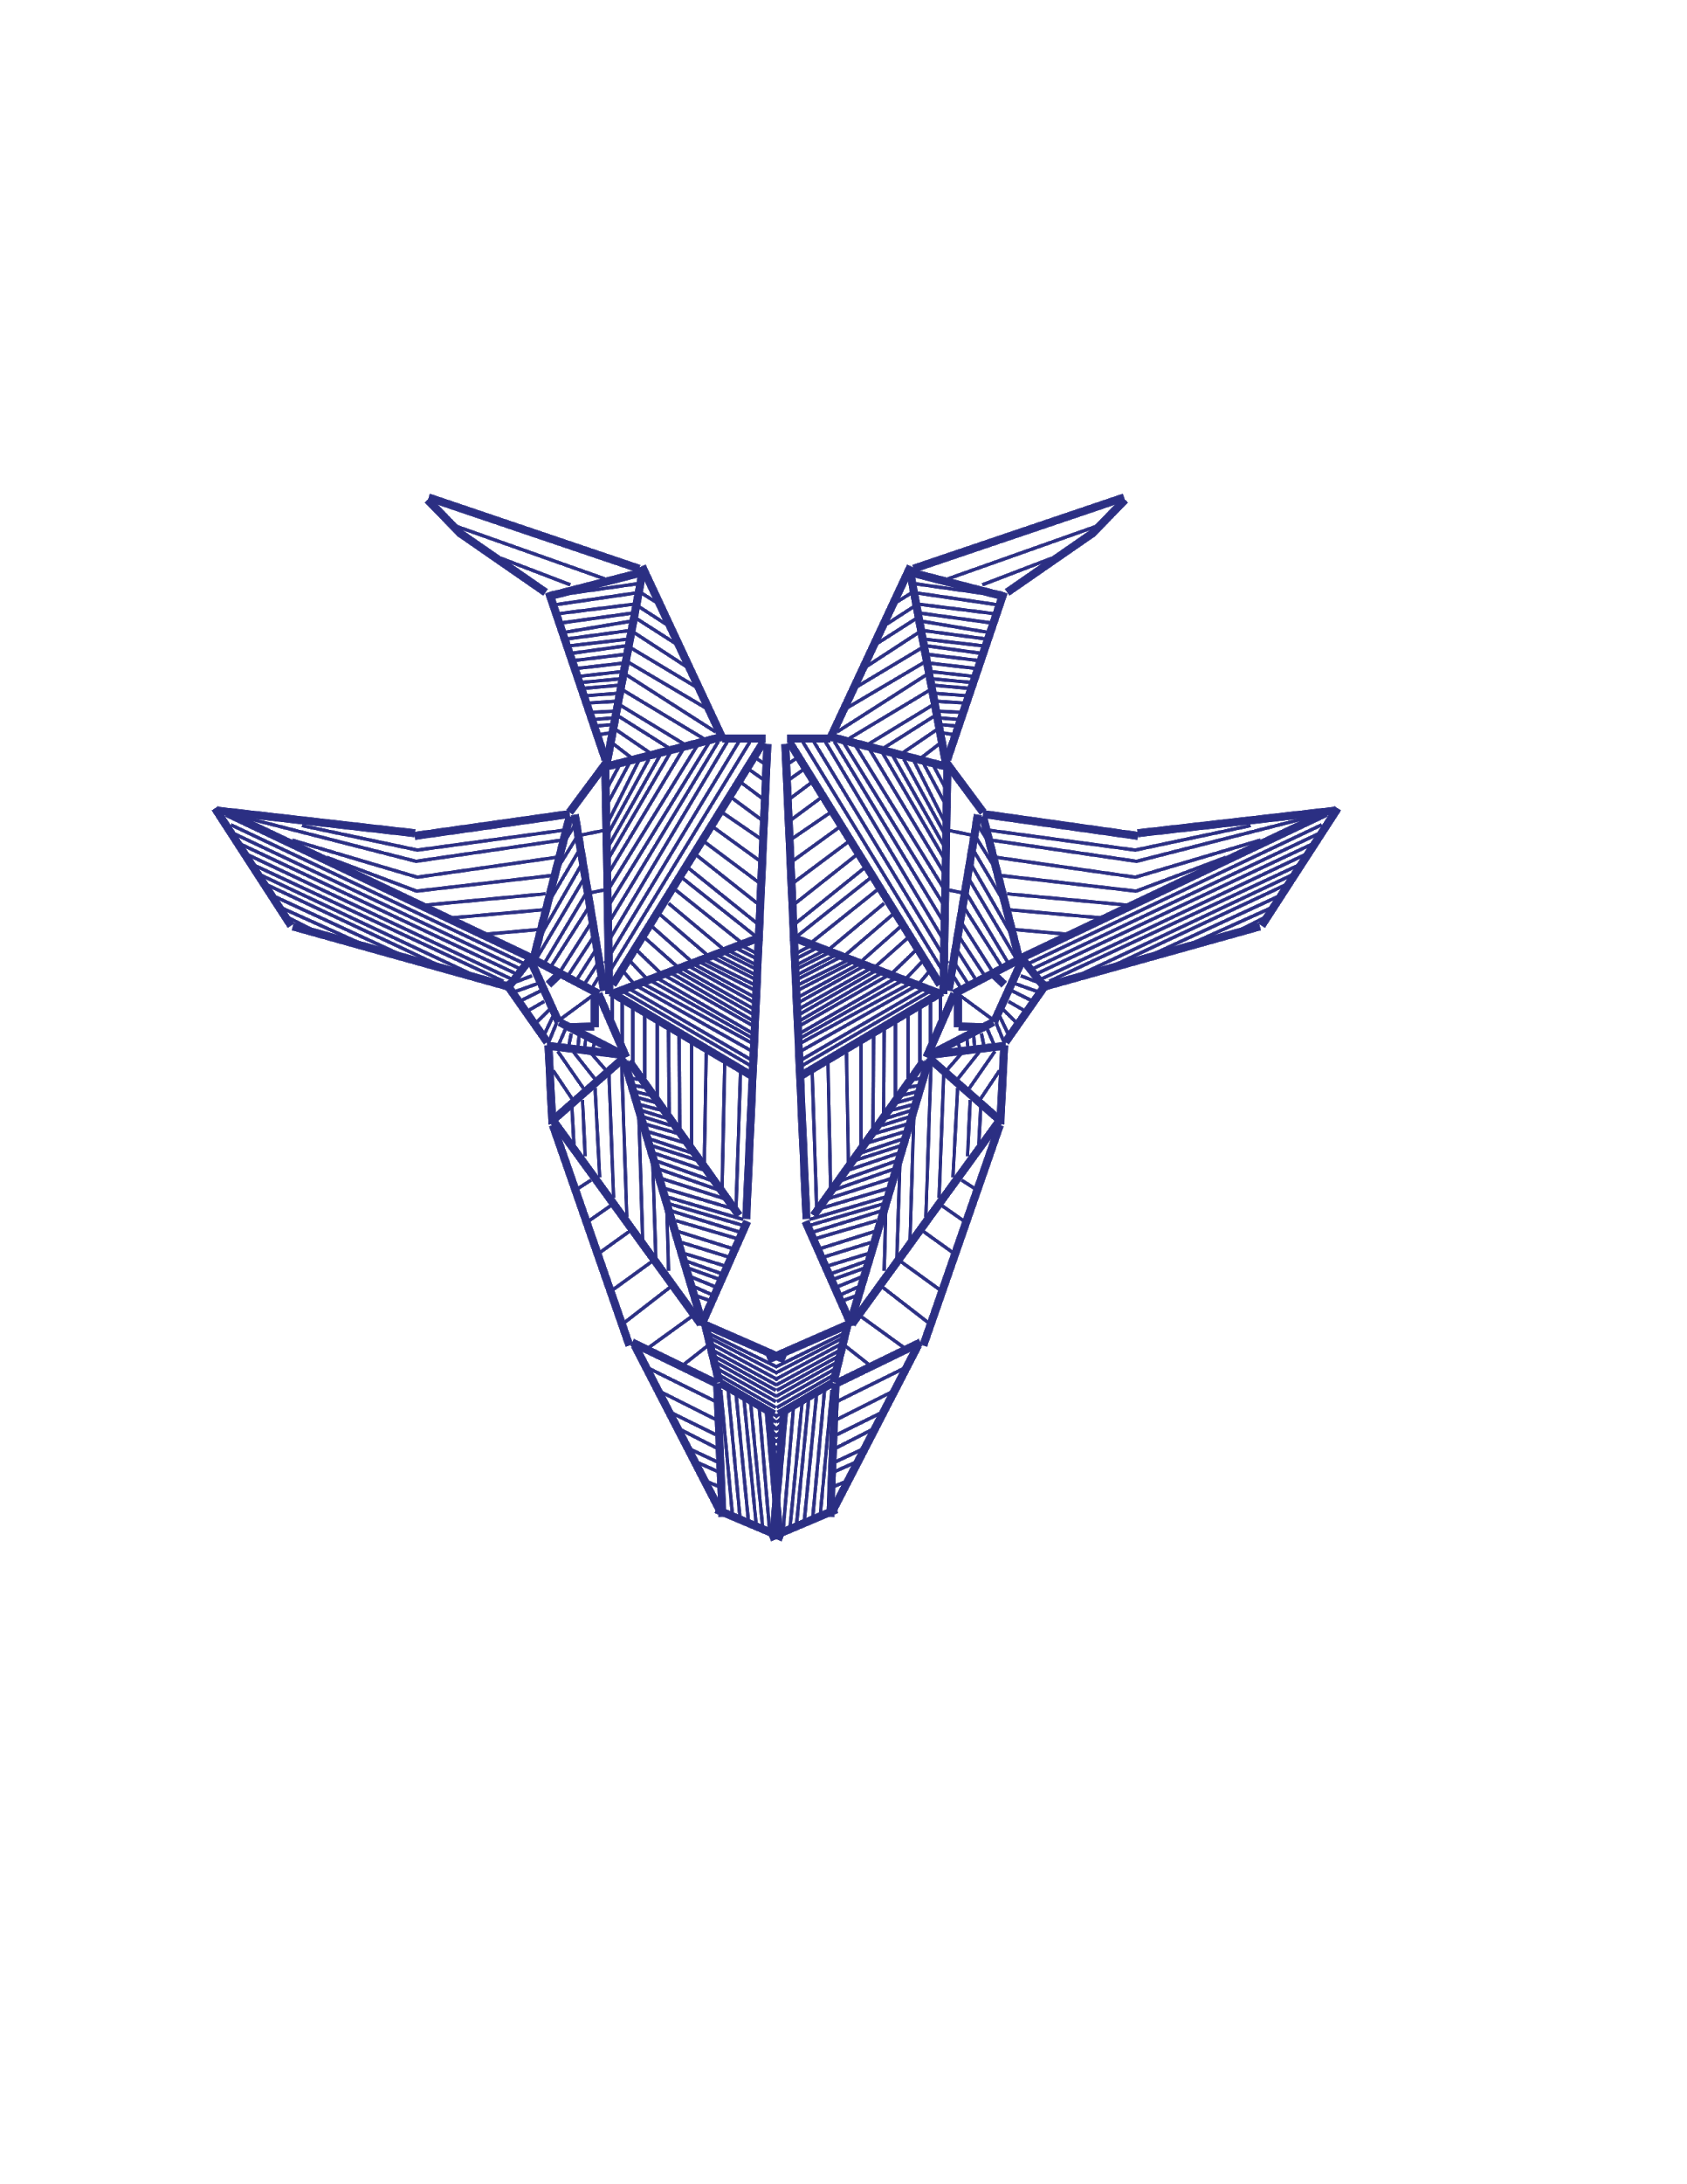
Pluto
By: Junbong “Edward” Jang, Clayton “Rhododendron” Dembski and Floris “Grashof?” van Rossum

Slide 2
Design Objectives
Remove and deposit a rod
Navigate to specific destination using a line follower
Align accurately in a specific orientation
Locate empty/full containers
Communicate with the field
Notes:
Floris

Slide 3
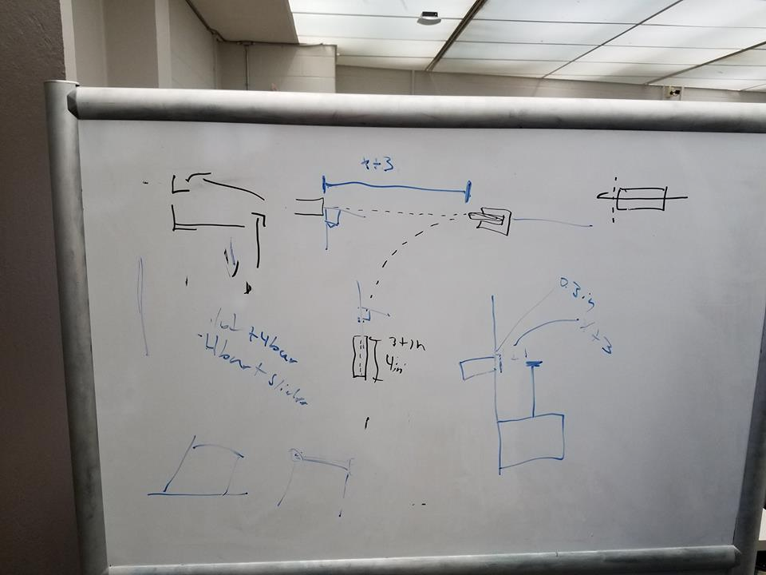
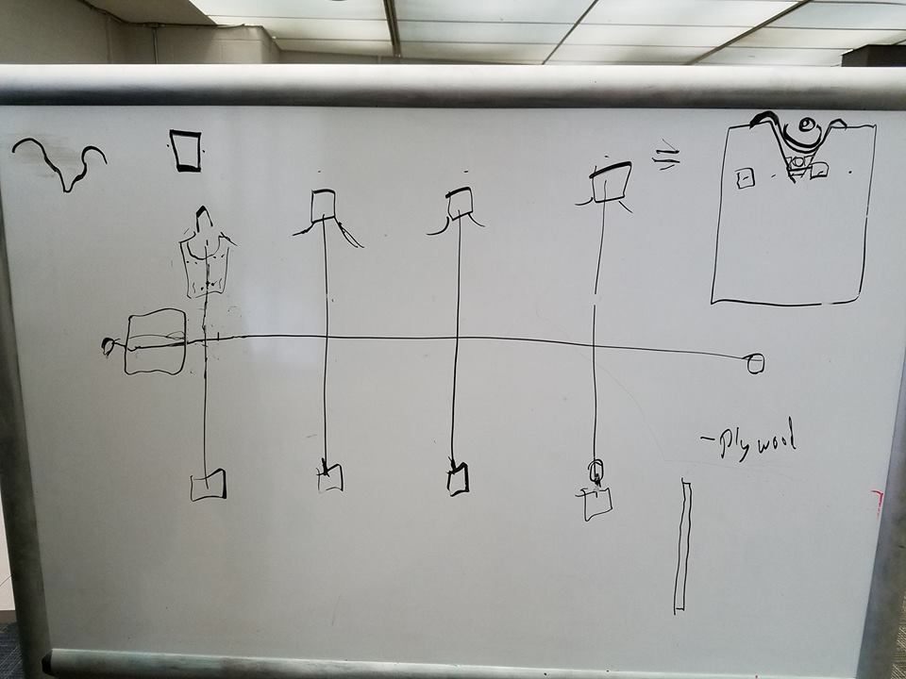
Early Design Decisions
Have two drive wheels
Have a turning center located between the drive wheels
Use a passive alignment mechanism
Four Bar with hard stops
Use a limit switch to detect arrival
Use encoders to measure orientation
Notes:
Clayton

Slide 4
The Drivetrain
Notes:
Floris

Slide 5
Drivetrain Decisions
4 wheels
Two Omni-wheels and two standard
Powered by two 393 motors
3:1 gear ratio initially
5:1 gear ratio currently
Encoders on standard wheels
Made out of 1/4 in plywood
Notes:
Floris

Slide 6
First Iteration of the Drivetrain
Notes:
Clayton

Slide 7
Improvements to the Drivetrain
More robust gearbox
Change in gear ratio
Move slower
Better passive alignment mechanism
Mounting holes for encoder and limit switch
Notes:
Edward

Slide 8
Final Iteration of the Drivetrain
Note: Top Plate is Transparent
Notes:
Floris

Slide 9
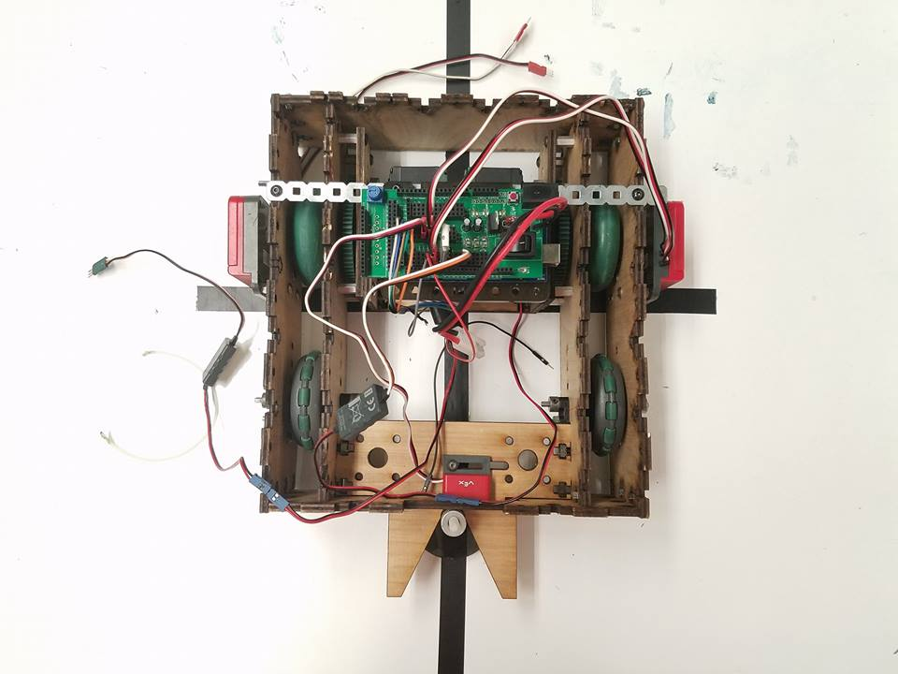
The Drive Train
Notes:
Floris

Slide 10
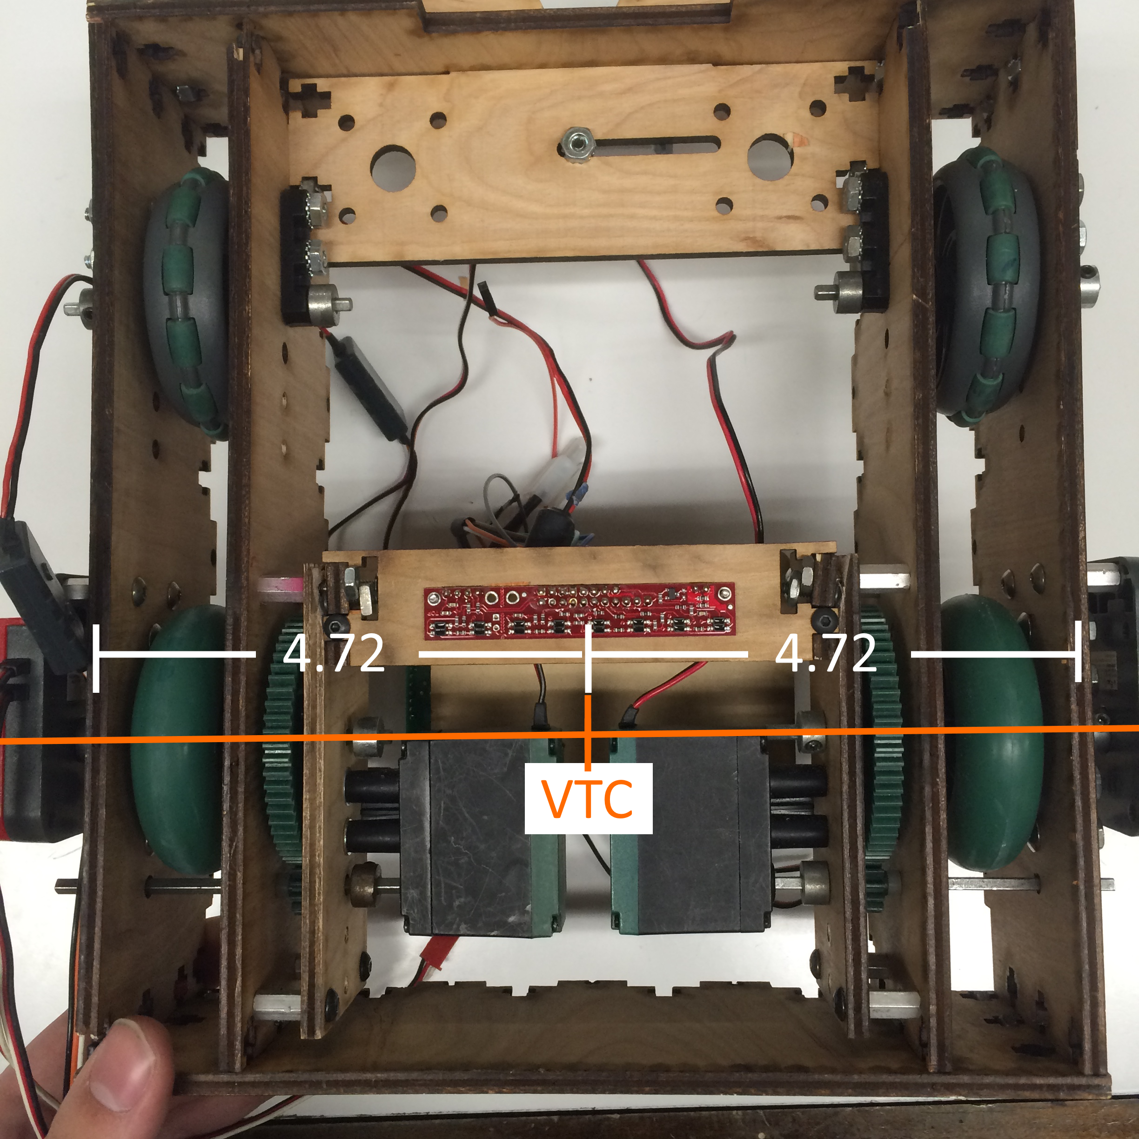
Drivetrain: Virtual Turning Center
Omni wheels in front
theoretical resistive force of 0 on the front wheels
VTC is between the two drive motors in back
Notes:
Clayton

Slide 11
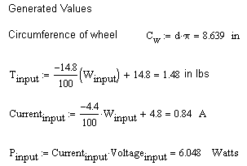
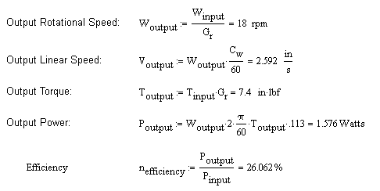
Drivetrain Analysis
Notes:
http://www.engineeringtoolbox.com/angular-velocity-acceleration-power-torque-d_1397.html, Edward

Slide 12
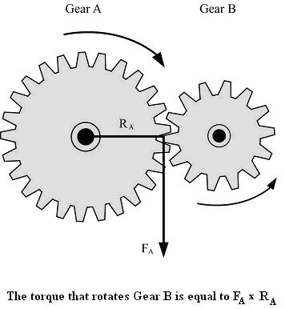
Gear tooth Analysis
Notes:
http://www.engineersedge.com/gear_formula.htm
https://www.vexrobotics.com/wiki/Gear_Kit Edward

Slide 13
The Four Bar

Slide 14
Lifter and Intake Design Decisions
Make a belt driven rod intake
Use a four bar
Have hard stops on the four bar
Minimize overshoot
Notes:
Floris

Slide 15
Preliminary Sketches of the Fourbar
Notes:
Floris

Slide 16
First Iteration of the Four Bar

Slide 17
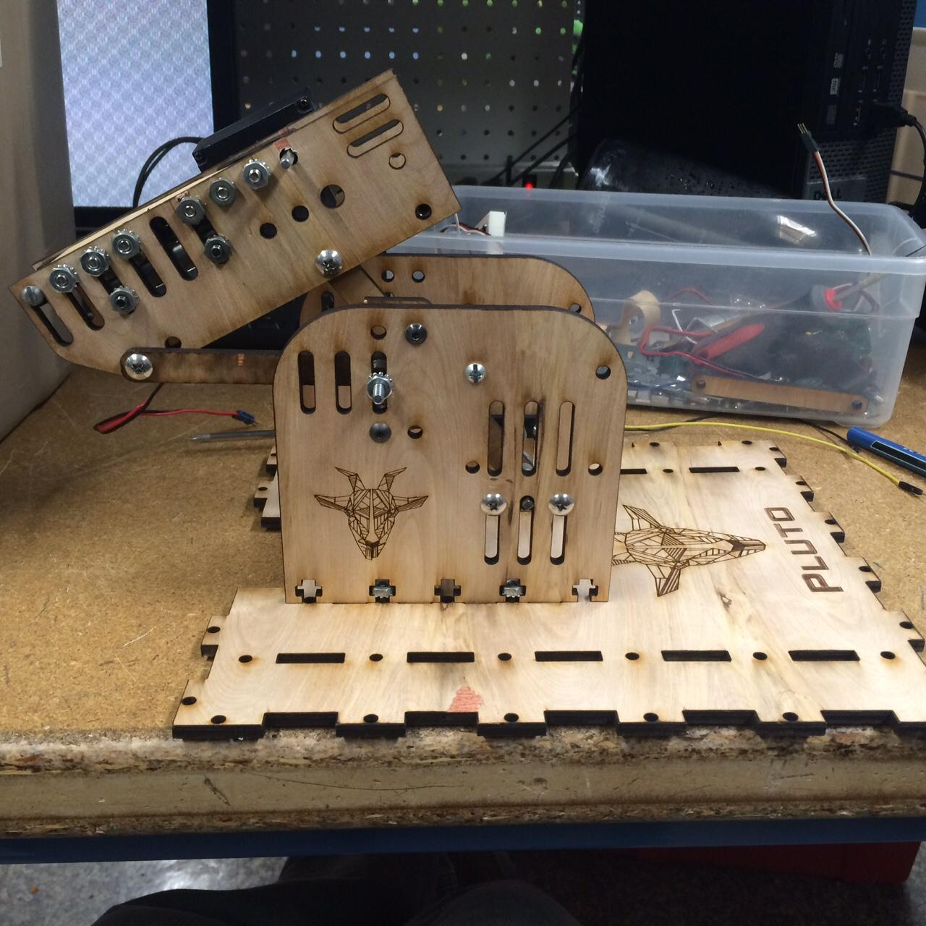
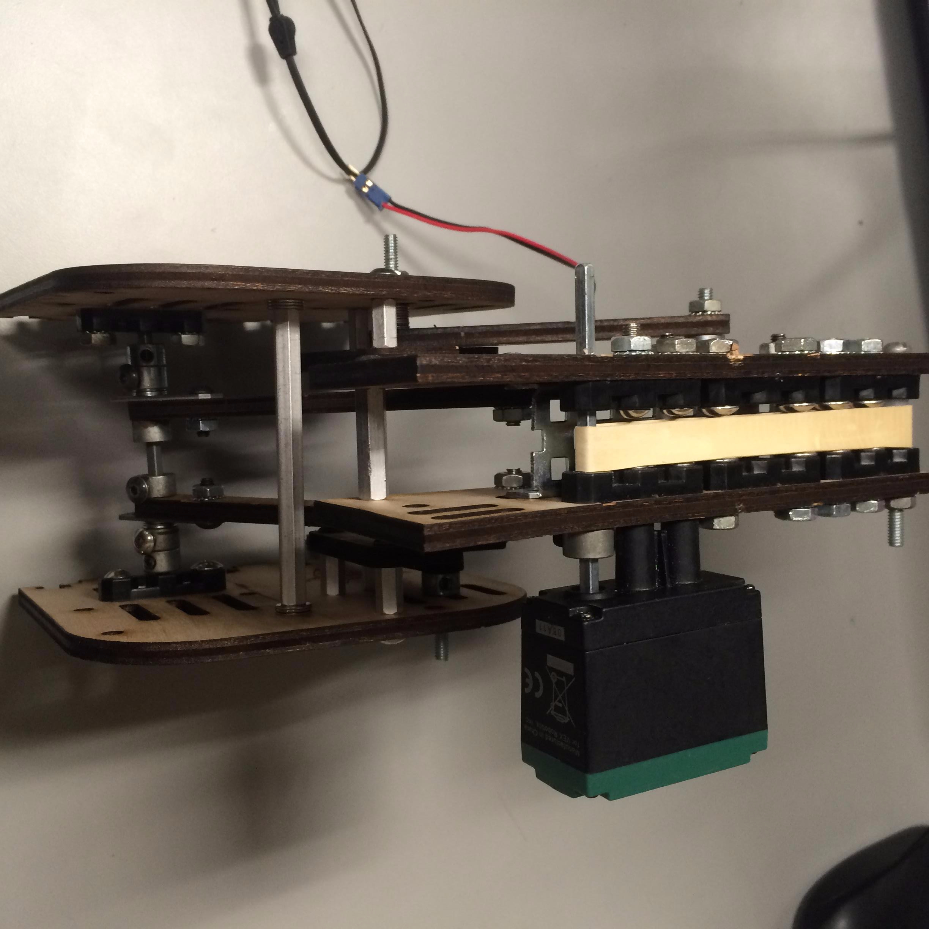
Final Iteration of the Four Bar
Notes:
Clayton

Slide 18
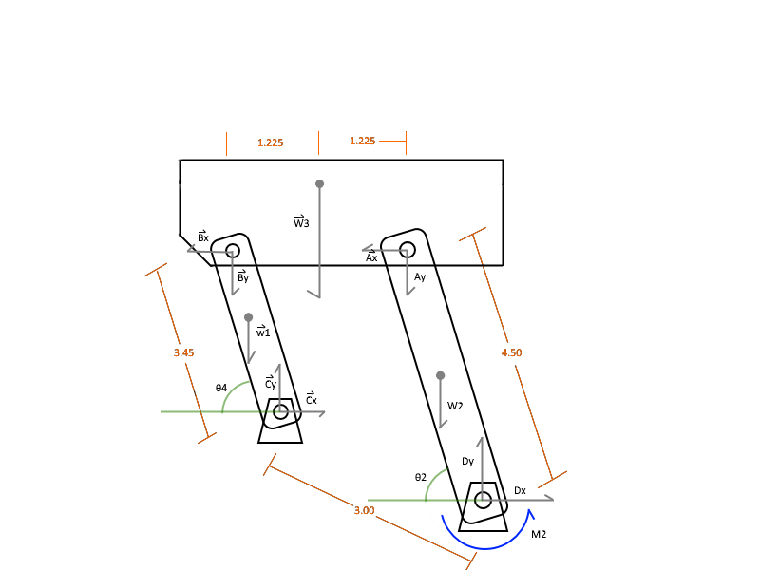
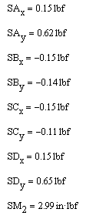
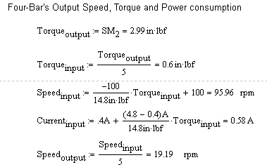
Four Bar Analysis
Notes:
Edward

Slide 19
Four Bar Analysis
Notes:
Floris

Slide 20
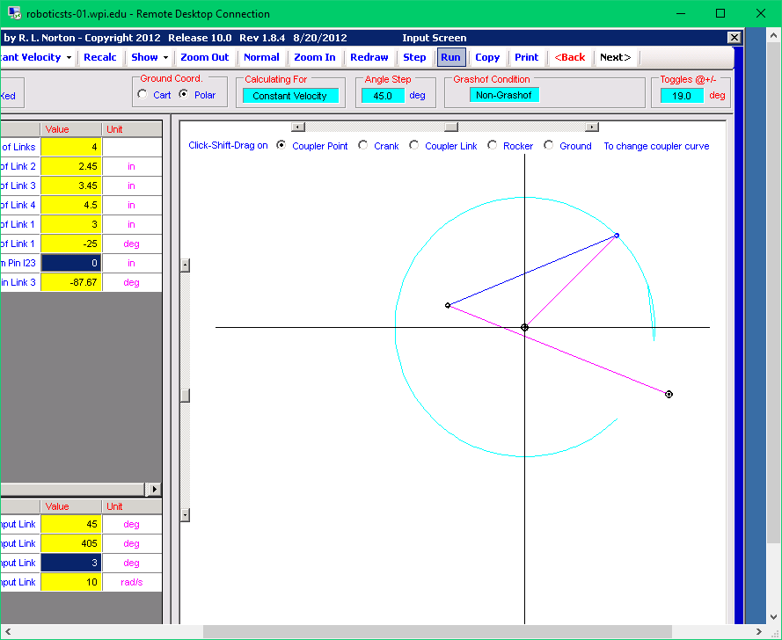
Four Bar Analysis: Norton Linkage Software
Notes:
Floris

Slide 21
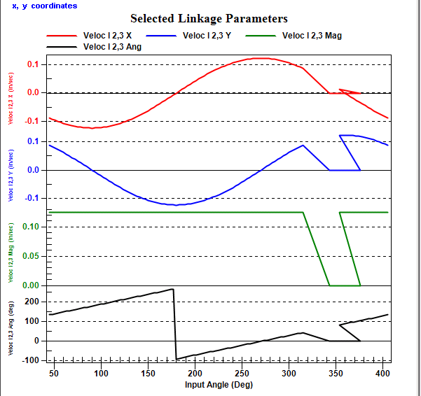
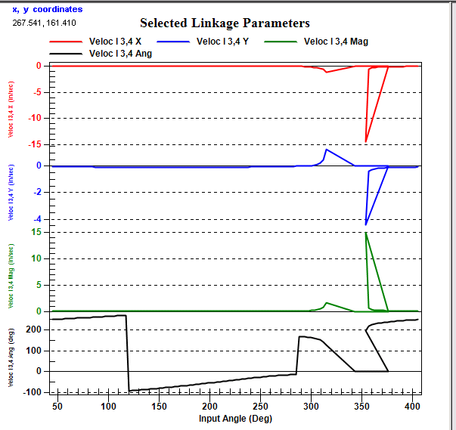
Four Bar Analysis: Norton Linkage Software
Notes:
Floris

Slide 22
Electrical Analysis
Notes:
Edward

Slide 23
Sensors & Code

Slide 24
Sensor Decisions
Limit switch to detect when container is reached
Encoders to turn 90/180 deg
PID controlled
Linefollower
Position in front of VTC
Potentiometer on four bar
PID controlled
Notes:
Floris

Slide 25
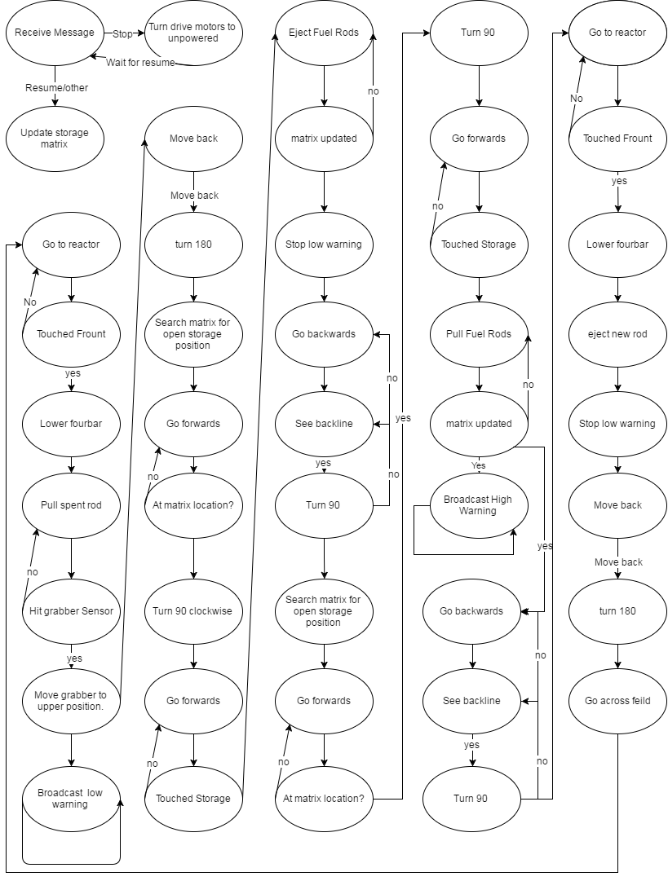
Initial Code: Flowchart
See: http://imgur.com/aCvkfWZ
Notes:
Clayton & Edward

Slide 26
Final Code
Object Oriented
BtComms | Messages | Linefollower | Fourbar
writeMessageWithData(unsigned char b1, unsigned char b2, unsigned char b3, unsigned char b4) //(type, source, dest, data) | read(bool *stopped) | precisionDrive (int, Servo, Servo) | double pidCompute(int, int);
 | LowWarning() | turnNinety (int, Servo, Servo) | void moveFourbar(int, Servo, int);
 | HighWarning() | Position matrix
 | decodeAndUpdate()
Notes:
Clayton

Slide 27
Current Status and Future Improvements

Slide 28
To-do
Rebuild the final four bar
3D print grabber funnel/redesign grabber
Make wiring neater
Create Bottom Mechanical Stop
Create hole in top plate for wires
Create arduino mount
Finish code
Test code
Notes:
Clayton

Slide 29
Pluto

